Slide 1
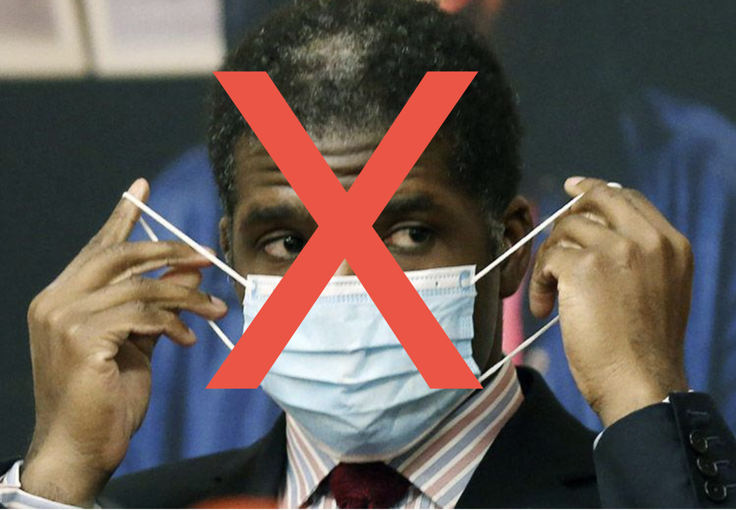
#UnethicalEchols
Lexi Corniello, Ben Foulkes, Maeve Heumann, Madeline Reichert
Notes:
MAEVE

Slide 2
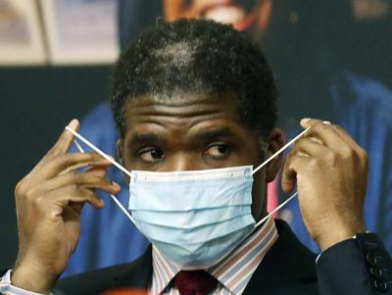
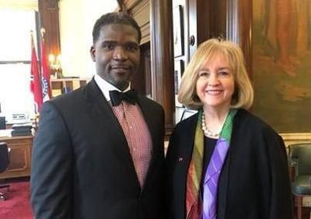
Dr. Fredrick Echols
Dr. Fredrick Echols is the Director of the City of St. Louis Department of Health and the first medical doctor to serve as health director since 2007. Prior to becoming Director he served as the Director of Communicable Disease, Vector and Veterinary Programs for the St. Louis County Department of Public Health, where he was responsible for overseeing daily operations
He is a current member of the American Public Health Association, Council for State and Territorial Epidemiologists
Echols holds a bachelor’s degree in biology/premed from Clark Atlanta University and a medical degree from Boston University School of Medicine

Slide 3
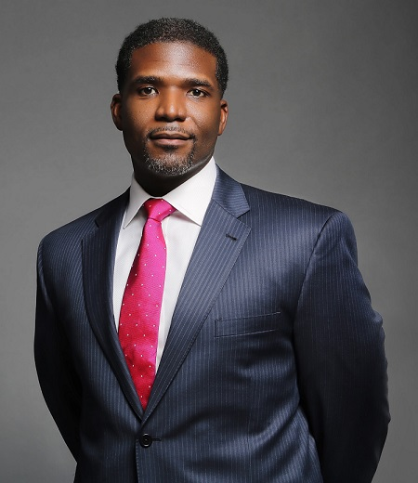
Background On Dr. Fredrick Echols
Is he qualified to keep us safe? Can he make the right decisions?
The man leading the city of St. Louis’ response to the Covid-19 pandemic was hired last year despite not meeting stated qualifications of his position.
He is not currently licensed to practice medicine. Due to his role in public health, he stopped seeing patients some time ago and did not maintain licensure," City Counselor Julian Bush wrote.
Notes:
MAEVE

Slide 4
Methods of Targeting
Using the social media hashtag #unethicalechols
Phishing via fake form to acquire personal information
Send to his staff asking their qualifications, trying to get more dirt on him/his team
Creating yard signs and bumper stickers to raise awareness
A GoFundMe page to gather monetary support to keep our campaign running until we get him out of office
Notes:
MADELINE

Slide 5
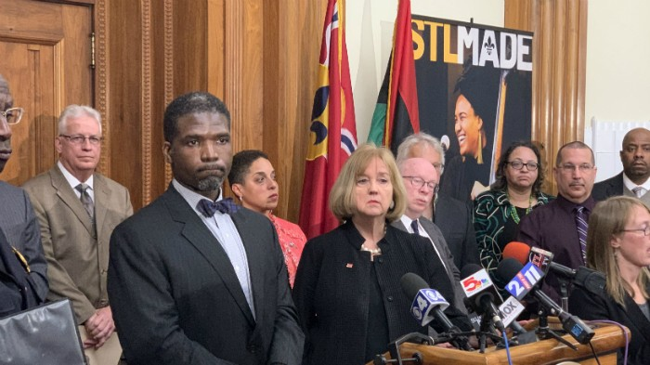
Recent Attacks Against Unethical Echols
May 2020 - Accusations of Expired Medical Qualifications
City lawyers sought to correct a ‘misstatement’ in his court testimonies on behalf of residents of a homeless camp downtown
Echols testified that he is not currently licensed to practice medicine
Two Lawsuits were immediately issued against him
ArchCity Defenders legal advocacy firm representing the homeless camp that Ethols ordered to have cleared
Lawyer involved in a separate legal action challenging the city’s Coronavirus-related stay at home order, Bevis Schock, said that he could use the questions about Echol’s qualifications to help his legal case.

Slide 6
Recent Attacks Against Unethical Echols (cont)
According to the city charter, the health department director must be a licensed physician, have a master’s degree in public health or “have been certified by the American Board of Preventive Medicine and Public Health.”
Echols’ biographical information does not indicate he has an advanced degree in public health, and a search of Echols’ name on the website for the American Board of Preventive Medicine returned no results.
“I will have to say, very regretfully, because I think he’s done a splendid job as director of health and hospitals, I think he almost satisfies those requirements, but he’s not quite there,” Bush said. - City Counselor Julian Bush
In light of these recent accusations during this time of uncertainty, with the cause being a Global Pandemic and Health Crisis, Echols was demoted to “acting” director of Health Department while his qualifications are under observation

Slide 7
Motivation Behind Damaging His Reputation
He overstepped his jurisdiction in continuing local stay at home orders while Missouri lifted its restrictions.
He deprived business owners of their right to their property which is a Amendment right
Directly attacked the livelihood of popular businesses around St.Louis that would easily gather support from the St.Louis people
Notes:
MADELINE

Slide 8


Wheelhouse
St Louis officials including Dr. Echols are being sued because they issued stay at home orders to all non-essential businesses. The issue is that under Missouri law the only person allowed to issues these sort of closings is the Missouri Director of Health and Senior Services Dr. Randall Williams. Dr. Williams was not one of the officials who ordered this closer. Therefore Dr. Echols as well as the other officials who ordered this closers have stepped out of their jurisdiction. This violates the owners 1st and 14th Amendment which states that states should not deprive any person of property without due process of law.
Notes:
LEXI

Slide 9
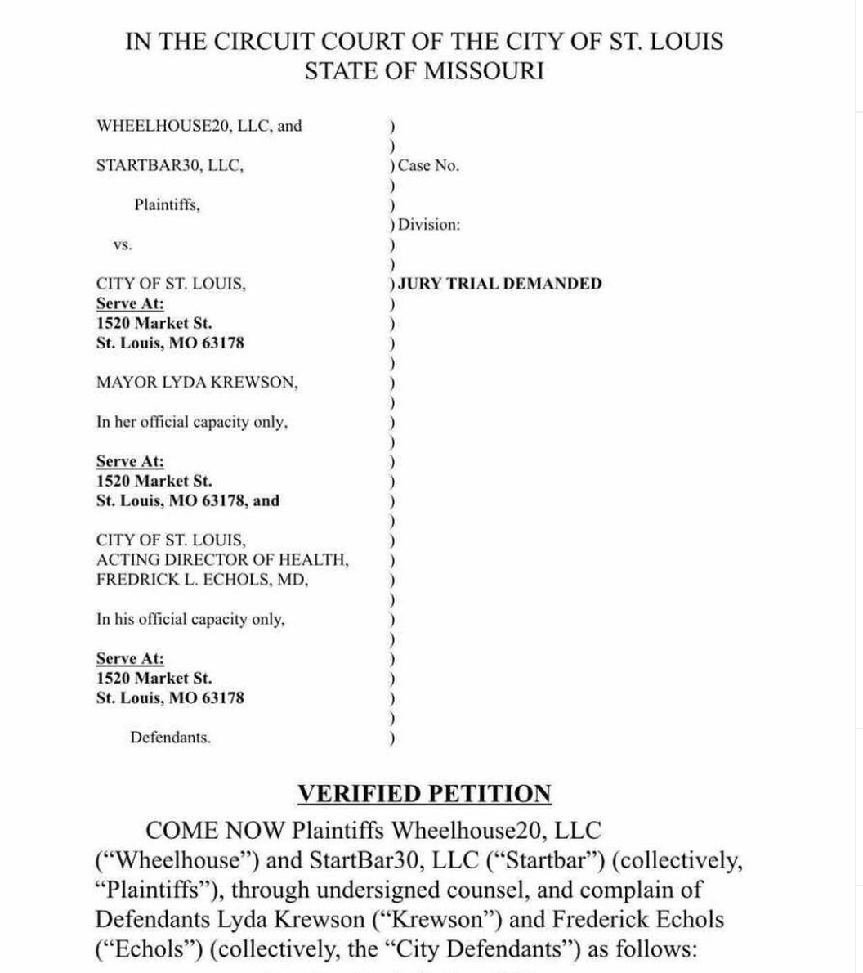
It pains us to say that we were issued a 2 week closure until November 30. The pain is solely for our staff and everyone affected by the unilateral decision of 1 person.⁣
⁣
Wheelhouse and Start Bar were issued a 2 week closure by the Health Director, Fredrick Echols, without due process and any correspondence except the notice ordering a shutdown. Due process would have given us the opportunity to show that his evidence was inaccurate, so much so that multiple photos weren’t even of Wheelhouse or Start Bar. ⁣
⁣
We made multiple attempts to reach out to Lyda, Fredrick and the City this week as their constituents to explain our side but they would not respond or meet with us. ⁣
⁣
That has given us no other choice but to file another lawsuit against them. The last thing we want to do is file a lawsuit against the city we have love so much, but we owe it to our staff, our customers and everyone who has supported us to stand up.⁣
⁣
It is our constitutional right to a fair due process. Our industries right. It is all of your constitutional rights as Americans. We are fighting for all of our rights and freedoms by filing this. ⁣
⁣
THANK YOU to everyone who has continued to support us the past 9 months. We apologize to all of the amazing customers who had reservations that we have to cancel, we truly appreciate the support and hope you reschedule when we open. Make sure you spend the weekend out at other establishments around the city because we know they are hurting just like us.
Notes:
LEXI

Slide 10
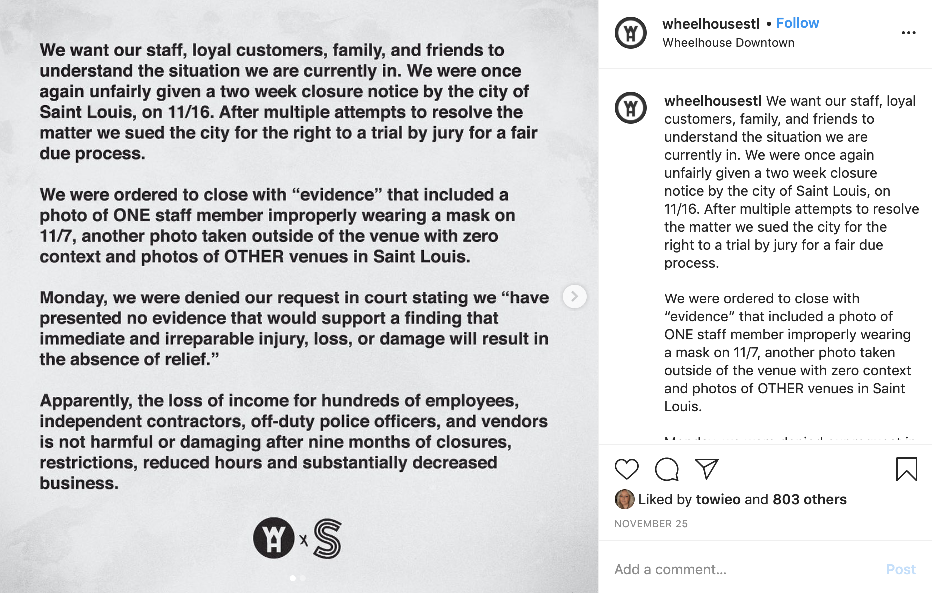
Notes:
LEXI

Slide 11
Email & fake form
Create a fake form to try to gather intel on his staff to use against him
Some questions will be their education background, their role in combatting COVID-19, the things they believe are working/not working, how certain staff members are handling this, and any general comments / concerns on how COVID-19 is being dealt with by the department
The form will pose just as a general consensus on how the staff believes they are handling it and where improvements can be made
By doing this, we can hopefully gather information that has not been disclosed to the public, that can strengthen our campaign against Echols.
Notes:
BEN

Slide 12
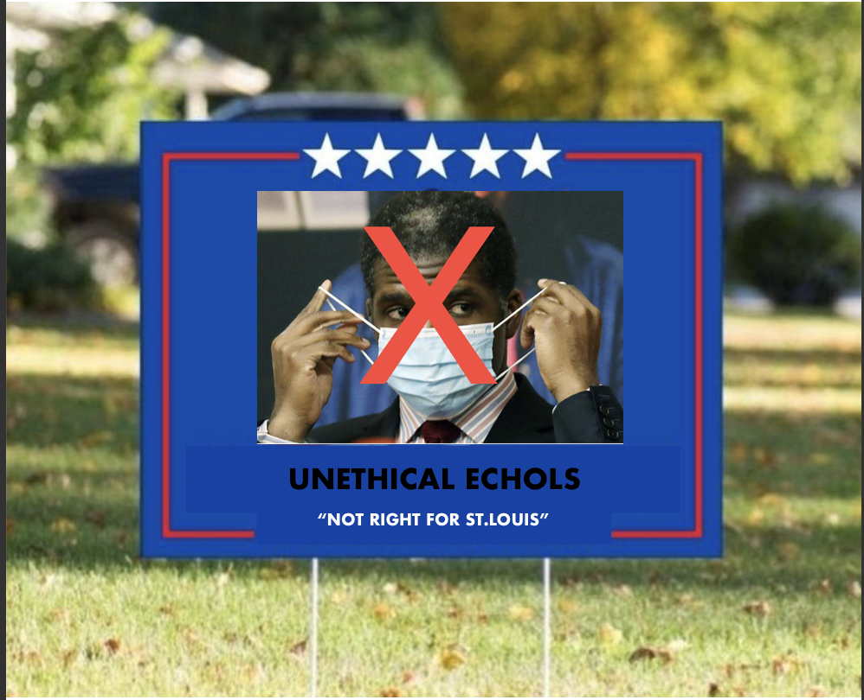

Getting The Word Out
& Making Profit
Social Media propaganda using #unethicalechols
GoFundMe donations
Use of yard signs to deteriorate his image
Bumper stickers
Notes:
BEN

Slide 13
Sources
St. Louis health director did not maintain medical license (msn.com)
https://www.ksdk.com/article/money/business/wheelhouse-start-bar-lawsuit-st-louis/63-4e299c6c-8ce8-4887-ab30-ffee35a041f3 http://www.stlamerican.com/your_health_matters/covid_19/all-12-covid-19-deaths-in-the-city-of-st-louis-were-black/article_da7ed56c-79d1-11ea-85bc-7b8539eaf346.html
St. Louis Public Health Director Doesn't Meet Requirements, City Counselor Says | News Blog (riverfronttimes.com)
Coronavirus St. Louis: Businesses sue over stay-at-home orders | ksdk.com
https://www.stltoday.com/lifestyles/health-med-fit/coronavirus/judge-denies-request-by-2-downtown-st-louis-bars-to-block-shutdown-order/article_609a146a-1a6b-59ed-82f5-9eb755dd84c9.html

